Slide 1

Social Media Automation Tools
DevOps Certification Course
www.fixityedx.com

Slide 2



What is social media automation?
Social media automation: Utilizing tools or software to manage repetitive tasks on social platforms
Saves time on posting content, basic customer service, and analytics reports
Tasks you can automate in social media marketing include post scheduling, basic customer service, and generating analytics reports
Generative AI tools can assist with brainstorming content ideas for text-based content, visuals, and videos
www.fixityedx.com

Slide 3
What is social media automation?
Social scheduling and publishing
Automatic social media posting saves time and increases efficiency
Eliminates the need for manually switching between different social accounts
Ensures content is posted at optimal times for each platform
Maintains content quality while reducing manual effort
Allows scheduling of content pieces and post times on each network
Enables a hands-off approach, letting automation take over the posting process
www.fixityedx.com

Slide 4
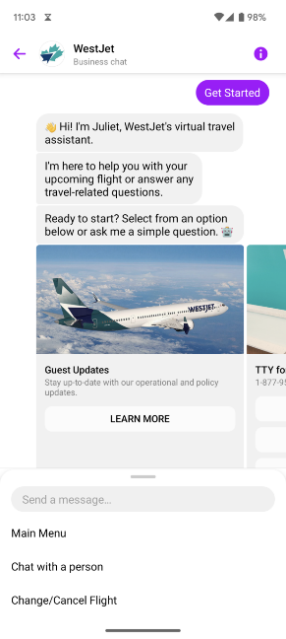
What is social media automation?
Basic customer service
Massive dip in online customer satisfaction rates observed in 2023 social trends report
Business owners shifted focus away from online customer service post-COVID
Opportunity exists in ecommerce market for businesses to improve customer service
Utilize customer interaction automation to address common inquiries and service requests
www.fixityedx.com

Slide 5
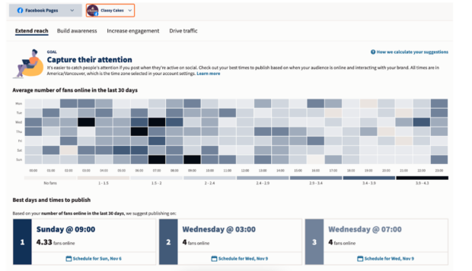
What is social media automation?
Data collecting
Automated data collection streamlines analytical reporting and decision-making in social media marketing
Automated data collection can include things like:
Platform-specific social data
Post engagement stats
Right tool can automate reporting, generating client-ready dashboards and reports with ease
www.fixityedx.com

Slide 6
What is social media automation?
DON’T use spammy bots
Use bots for positive purposes that enhance customer experiences and operational efficiency
Embrace AI tools that improve customer service response times and streamline inbox management across multiple networks
Avoid using bots for automatically commenting on or liking social posts
Such actions can damage relationships with the audience and lead to repercussions from social networks
Prioritize ethical and responsible use of automation tools to maintain trust and credibility with your audience
www.fixityedx.com

Slide 7
What is social media automation?
DON’T cross-post without customizing
Avoid automatic cross-posting of the same content across multiple social media platforms
Different platforms have distinct image display ratios, character limits, and audience expectations
Adjust your message for each platform's audience and features
Review user handles, image specs, text, and hashtags for platform-specific optimization
Utilize automated social media publishing at set times for efficient time management
Instead, take the time to adjust your message for each platform’s audience. At the bare minimum, you’ll want to review:
User handles, which can vary between platforms
Image specs, like file type, size, cropping, etc.
www.fixityedx.com

Slide 8
Top Social Media Automation Tools
1. Hootsuite
Hootsuite: Comprehensive social media management platform with extensive automation features
Streamlines social media marketing efforts by managing all accounts from one place
Ideal for medium-to-large teams, social media marketers, and content creators
Key automation tools include:
Scheduled posts: Plan and schedule content in advance for optimal timing
Here’s a breakdown of Hootsuite’s key automation tools and why you should care about them.
www.fixityedx.com

Slide 9
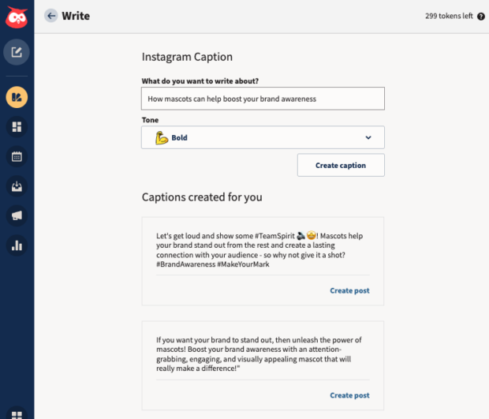
Top Social Media Automation Tools
OwlyWriter AI
OwlyWriter AI is Hootsuite’s AI-driven, social-media-specific content-generating tool. Use it to save major time generating and testing social media captions.
www.fixityedx.com

Slide 10
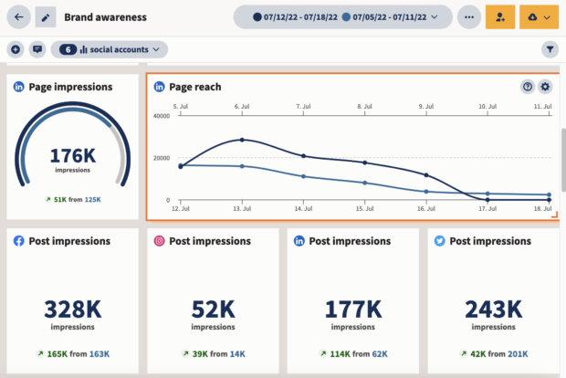
Top Social Media Automation Tools
Analytics
Social platforms' native analytics tools require separate analysis and manual report compilation
Analytics simplifies this process by offering custom boards for tracking desired metrics
Automated reporting feature exports and sends data to clients, managers, or yourself effortlessly
Measure content performance with real-time updates and high-level overviews for periodic reviews
www.fixityedx.com

Slide 11
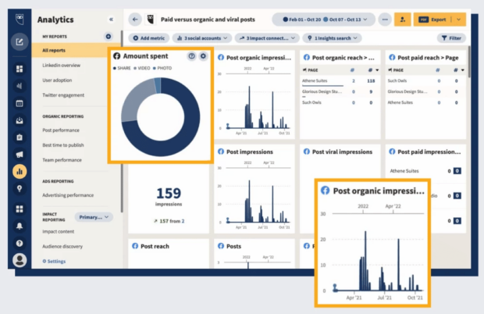
Top Social Media Automation Tools
Social Advertising
Social Advertising: Enables testing of hundreds of Facebook and Instagram ads
Automatically reallocates budget to best-performing ads for maximum ROI
Ensures targeting of right audiences with appropriate metrics
Automated budget boosting and new campaign initiation based on pre-set triggers
Provides daily automatic ad performance recommendations
www.fixityedx.com

Slide 12
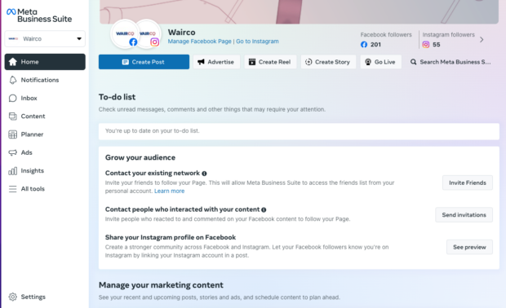
Top Social Media Automation Tools
2. Meta Business Suit
Meta Business Suite: Offers tools for automating social media posts, Stories, ads, and analytics on Meta platforms
Limited to scheduling posts only for Meta accounts (Instagram and Facebook)
Not suitable for content creators or marketers on LinkedIn, Pinterest, YouTube, or Twitter
Ideal for smaller teams exclusively using Instagram and Facebook
Larger teams requiring content approval workflows may need to explore alternative solutions
www.fixityedx.com

Slide 13
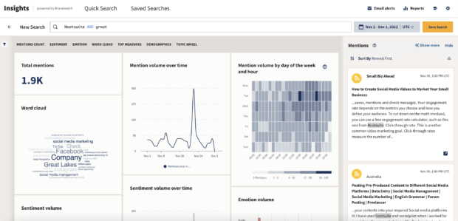
Top Social Media Automation Tools
3. Brandwatch
Brandwatch: Automates social listening by analyzing real-time social conversations
Provides alerts for spikes in social conversation or sentiment
Alerts inform of potential crises or viral hits before they happen
Acts as a resident watchdog for your brand's social presence
Set up listening streams and let Brandwatch work for you
www.fixityedx.com

Slide 14
Email marketing terms
Email marketing tools are used by marketers to create, send, test, optimize, and report on email campaigns
Common email marketing tool: Email Service Provider (ESP), e.g., Campaign Monitor
ESPs enable creation of beautiful emails, automated journeys, and personalized messages to improve customer relationships
Integrations with key technologies like Salesforce allow for automatic data pull to power personalized email campaigns
Choosing the right email marketing software requires consideration of features appropriate for business goals
Campaign Monitor offers various pricing plans including Pay As You Go and robust plans to suit different needs
www.fixityedx.com

Slide 15
Features of Email Marketing
There are various features of email marketing:
1.HTML, Responsive Layout
2.Easy Integration
3.Deliverability Help
4.Dedicated IP Address
5.CAN-SPAM Compliance Built-in
6.Advanced List Maintenance
7.Message Automation
www.fixityedx.com

Slide 16
Benefits of Email Marketing
The following are the benefits of email marketing:
Increase leads 9. Having a forum for self-promotion
Generating traffic to your site
Gathering feedback and survey
Sending timely campaigns
Creating personalized content
Improving sales
Communicating with your audience
Providing cost-effective campaigns
www.fixityedx.com

Slide 17
Drawbacks of Email Marketing
The following are the drawbacks of email marketing:
Keeping customers engaged
Being branded as a spammer
Delivery issues
Breaking the law
Design issues
www.fixityedx.com

Slide 18
Email Marketing Tools
Email marketing tools are utilized by marketers for creating, sending, testing, optimizing, and reporting on email campaigns.
Email Service Providers (ESPs) like Campaign Monitor are common email marketing tools.
Email marketing tool is defined as a software and application which we use in email campaigns. We use email marketing tools for:
Optimizing email Email Building
Generating email reports
Sending Email
Measuring email metrics
Email design
www.fixityedx.com

Slide 19
Types of Email Marketing Tools
HubSpot email marketing
Sender
MailerLite
Moosend
Mailjet
Mailchimp
Omnisend
Litmus
Drip
Mad Mimi
Constant Contact
Cake Mail
Flashissue
Zoho
www.fixityedx.com

Slide 20
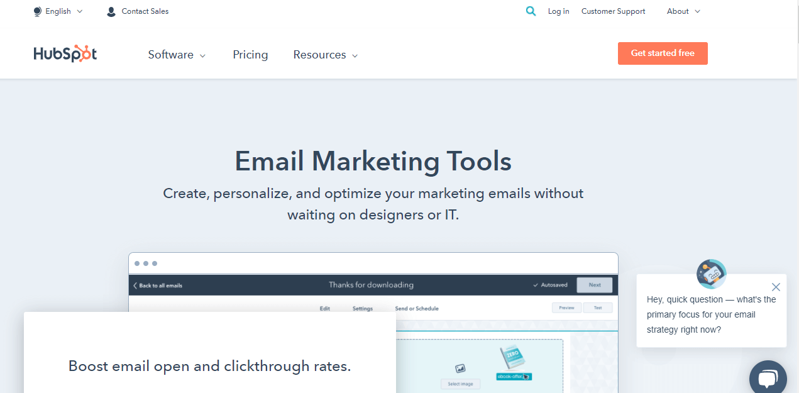
Types of Email Marketing Tools
HubSpot email marketing
HubSpot offers a free email marketing tool tailored for small businesses' transactional email needs.
Ideal for sending various types of messages, including lead offers, thank-you emails post-purchase, and campaign promotions.
Features an intuitive drag-and-drop visual editor for easy email creation.
www.fixityedx.com

Slide 21
Types of Email Marketing Tools
Sender
The sender distinguishes itself with superior deliverability features compared to other free email marketing tools.
Users can create visually appealing newsletters without needing HTML knowledge.
Templates are available for selection, and customization is effortless with components like text, images, and videos.
www.fixityedx.com

Slide 22
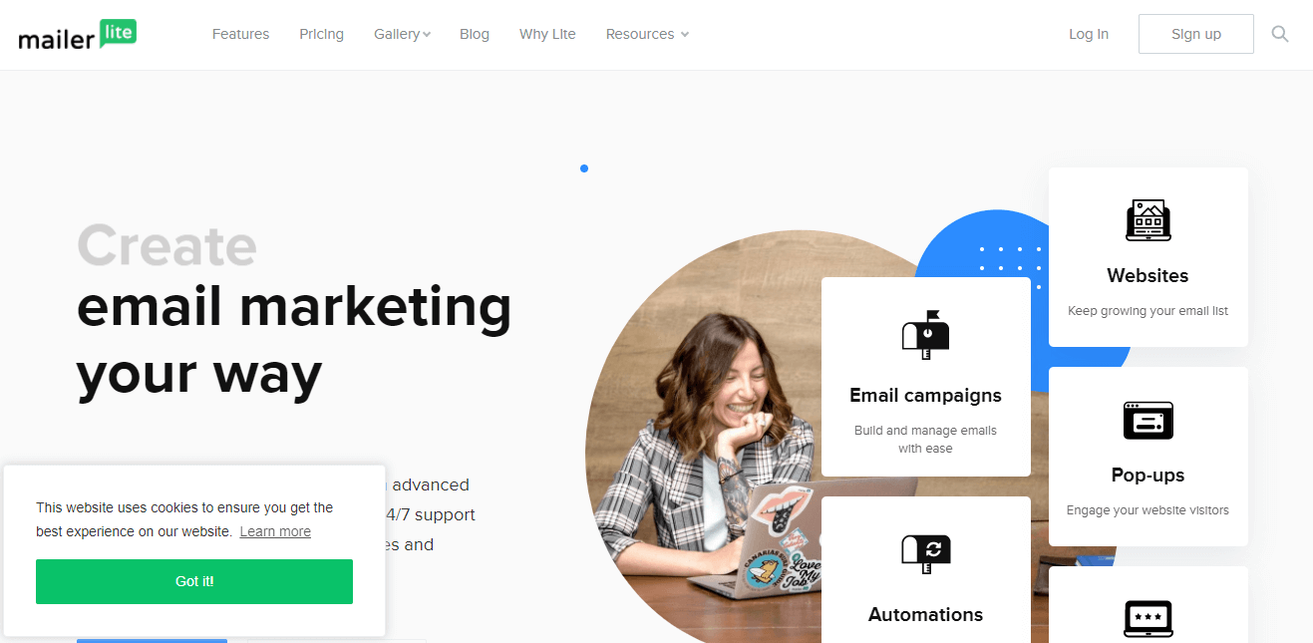
Types of Email Marketing Tools
MailerLite
MailerLite stands out among free email marketing tools with advanced features like a landing page builder and pop-up customizer.
In addition to essential features like drag-and-drop email builder, it offers a fantastic text editor and built-in photo editor for creating visually stunning emails.
www.fixityedx.com

Slide 23
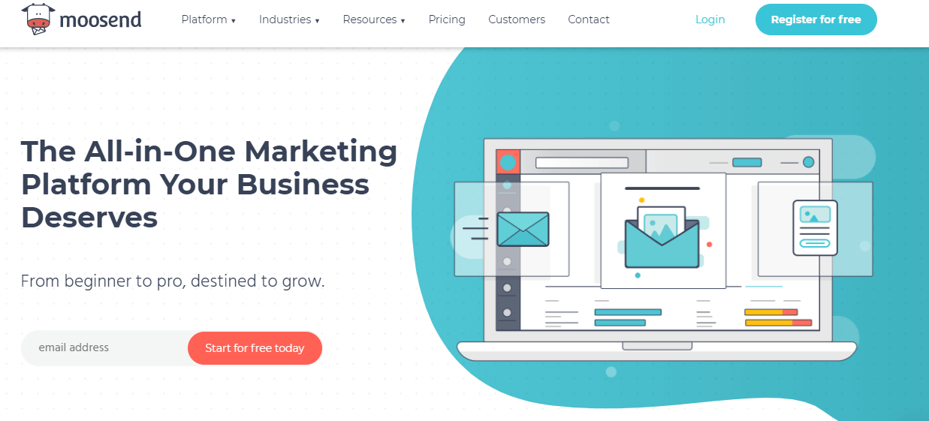
Types of Email Marketing Tools
Moosend
Moosend offers time-saving automation capabilities, streamlining tedious tasks in email marketing.
Users can create social email campaigns based on subscriber data and behavior, enhancing relevance and engagement.
Detailed performance reports provided by Moosend allow users to optimize campaigns effectively and improve results.
www.fixityedx.com

Slide 24
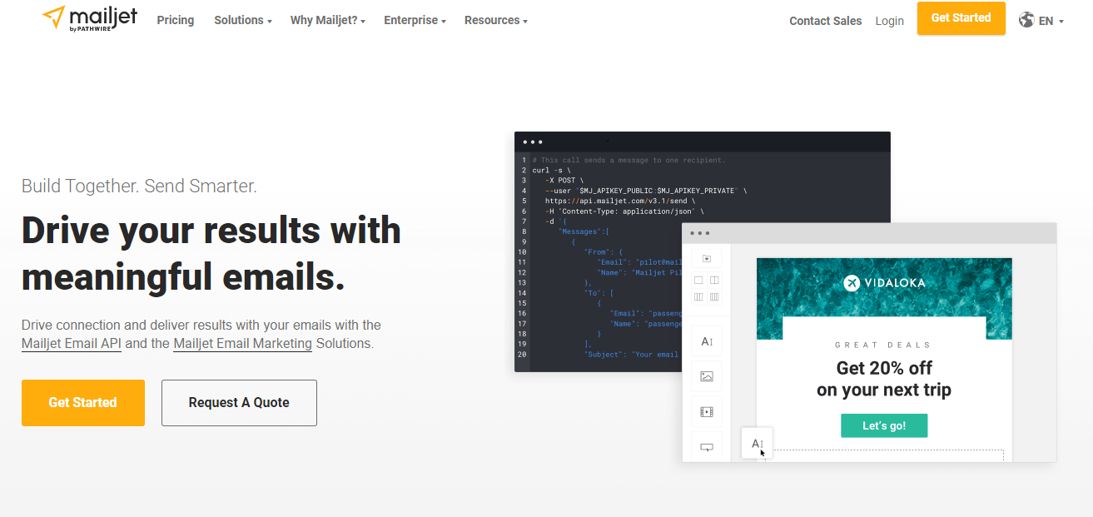
Types of Email Marketing Tools
Mailjet
The email marketing software offers intuitive and collaborative tools for building powerful campaigns.
Users can customize pre-designed templates and create responsive emails, ensuring compatibility across various devices.
Real-time collaboration features facilitate seamless teamwork for teams working on campaigns.
www.fixityedx.com

Slide 25
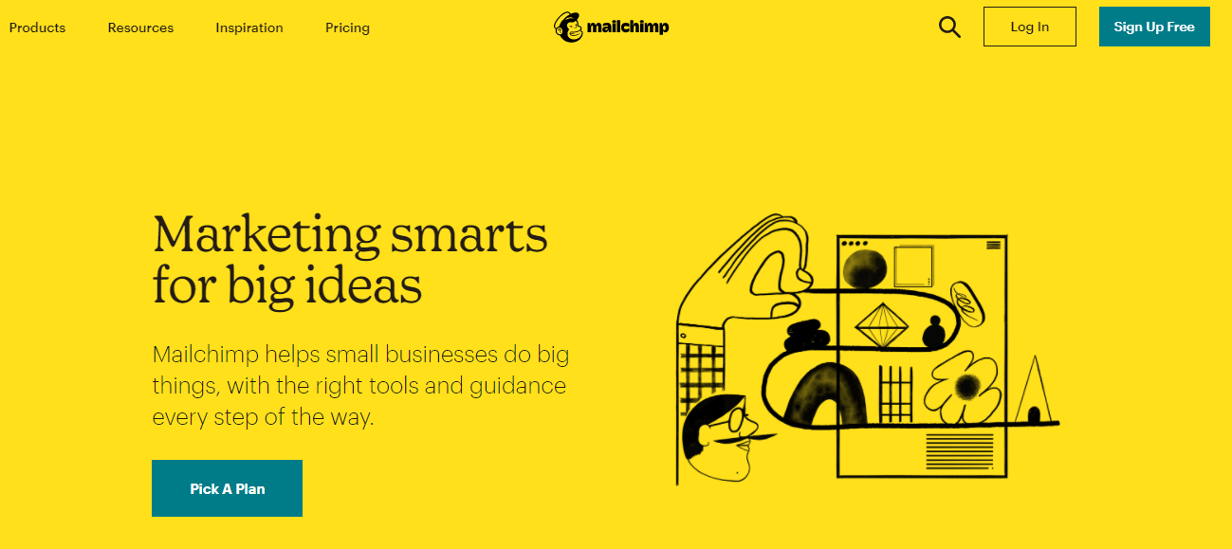
Types of Email Marketing Tools
Mailchimp
Mailchimp, a renowned innovator in email marketing tools, offers a free plan with essential features like email creation and scheduling.
Its standout feature is the recommendations feature, providing valuable audience insights to optimize marketing efforts.
The content manager simplifies email design by allowing users to save images and files for easy access within the platform.
www.fixityedx.com

Slide 26
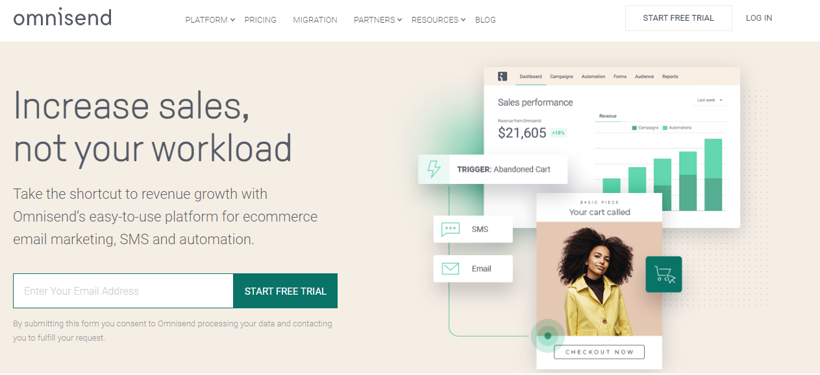
Types of Email Marketing Tools
Omnisend
Omnisend integrates all communication platforms into a single interface, streamlining management.
The free plan includes email marketing capabilities, adequate for small and medium businesses.
Automation features enable users to schedule email delivery based on behavioral triggers, optimizing timing.
www.fixityedx.com

Slide 27
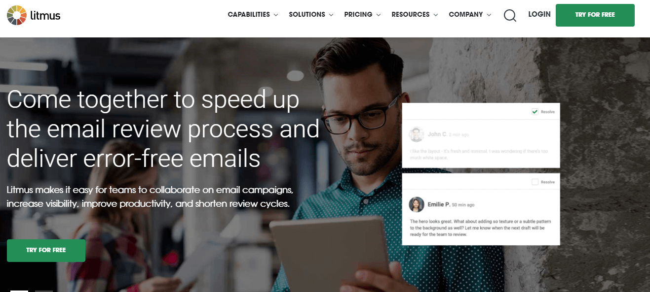
Types of Email Marketing Tools
Litmus
Litmus is a highly adaptable email testing and tracking tool, offering comprehensive testing across various web browsers and mobile devices.
Users can test their messages on popular mobile platforms such as Windows, Android, and Apple devices, ensuring compatibility.
www.fixityedx.com

Slide 28
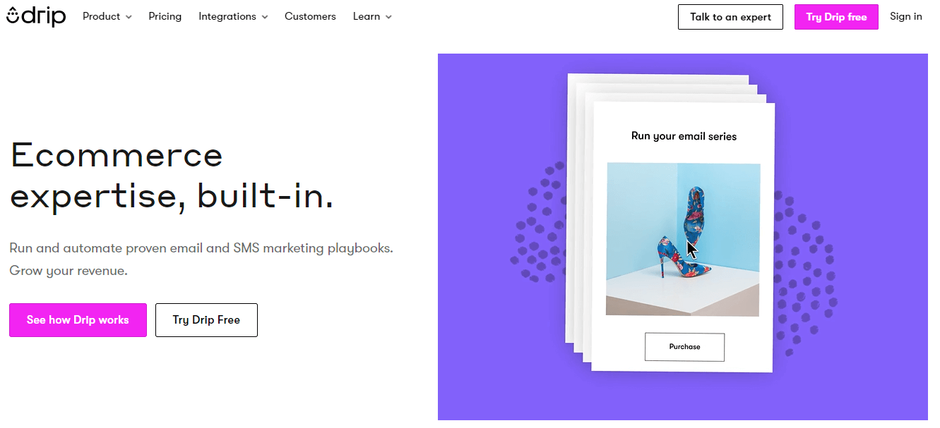
Types of Email Marketing Tools
Drip
Drip is a versatile email marketing platform offering integration with e-commerce platforms and comprehensive data analytics.
Integration with platforms like Shopify enhances the efficiency of e-commerce email campaigns.
Drip provides two tools for building emails: visual and text-based, catering to different marketing preferences.
www.fixityedx.com

Slide 29
Types of Email Marketing Tools
Mad Mimi
Mad Mimi offers a straightforward WYSIWYG editor for creating professional-grade emails with ease.
Users can choose from 39 networking buttons, including options like like, share, retweet, and pin, to customize emails and add links effortlessly.
The clone tool allows for the duplication of campaigns, enabling modification of the original document without altering previous versions.
The platform features an undo option, providing reassurance for users concerned about accidentally deleting email campaigns.
www.fixityedx.com

Slide 30
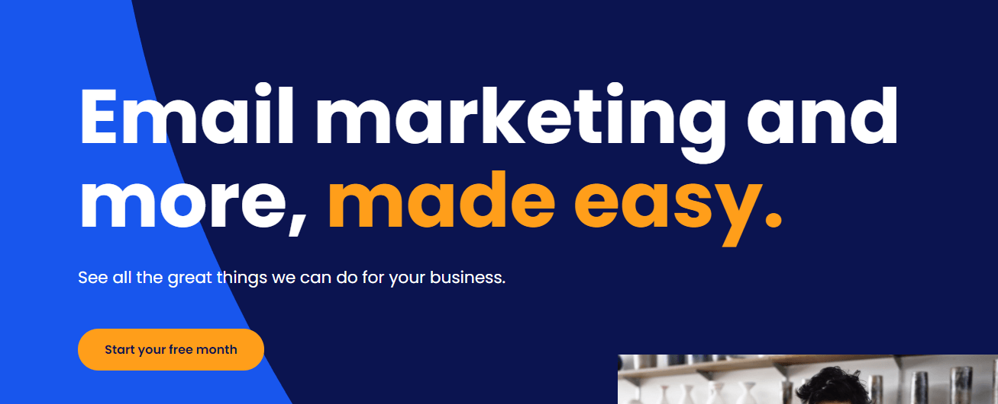
Types of Email Marketing Tools
Constant Contact
Design layouts: Choose from a variety of pre-designed templates or craft your own custom design.
Additional features: Add images, polls, documents, videos, and links to surveys to enhance engagement.
Text and picture import: Easily import text and images directly into the WYSIWYG editor for seamless content creation.
www.fixityedx.com

Slide 31
Types of Email Marketing Tools
CakeMail
CakeMail offers Split A/B testing functionality to determine the most effective mailing list and prevent messages from ending up in spam folders.
Spam Assassin integration ensures email deliverability by monitoring and preventing emails from being marked as spam.
The email sending process is seamless, requiring only a campaign title, email design, recipient selection, and scheduling.
Users can choose from twenty default layouts with fully customizable options or upload their own designs.
www.fixityedx.com

Slide 32
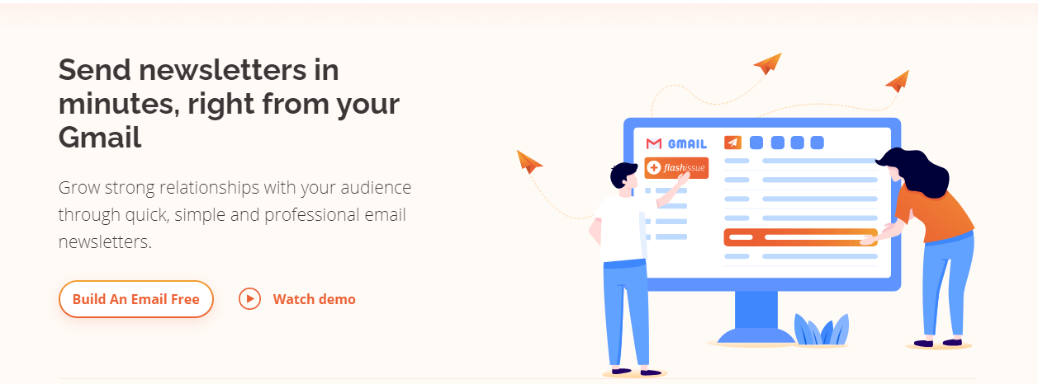
Types of Email Marketing Tools
Flashissue
Flashissue combines email marketing with content curation, offering a simple interface for newsletter creation.
Users can sign in via Facebook or Google and have newsletters sent to their contacts within five minutes.
The editor enables users to upload banners and choose the ideal method of delivery for their newsletters.
www.fixityedx.com

Slide 33
Types of Email Marketing Tools
Zoho
The campaign process of Zoho is separated into three areas: Basic Details, where you can choose the name of the campaign and the details of the email, the Audience, and Content. The Last is self-explanatory.
When you select your beneficiaries and other details of the campaign, then you can complete your campaign.
www.fixityedx.com

Slide 34
DevOps Certification Course
Thank You !!
www.fixityedx.com

